Slide 1
Company Name

Slide 2
Company Leaders
Member 1
Member 2
Member 3
Members Role
Members Role
Members Role

Slide 3
Product/Service
Provide a description of your product or service

Slide 4
Problem
Explain how you came up with your product/service and what problems it will solve

Slide 5
Competition
Top Competitor
Other Direct Competitors
Indirect Competitors
Give Basic info on your main competitor and why they are your main competitor
Other Companies that do the same thing as you and will directly divert customers from your company
Companies that will draw customers from you but do not directly compete

Slide 6
Competitive Advantage
What does your company do the different or better than the companies you are competiting with?

Slide 7
How will you Sell?
Describe the markets you plan to sell you product/service to and a little about that target group (use industry data)

Slide 8
Marketing
Marketing Route 1
Marketing Route 2
Marketing Route 3
Provide a brief description of one marketing path and how you will use it
Provide a brief description of one marketing path and how you will use it
Provide a brief description of one marketing path and how you will use it

Slide 9
Operations
Cover the basic operations of your company. (Employees needed, where you will produce, etc.)

Slide 10
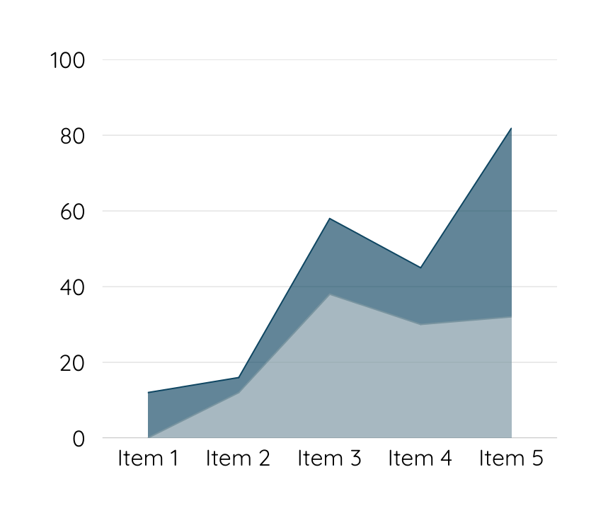
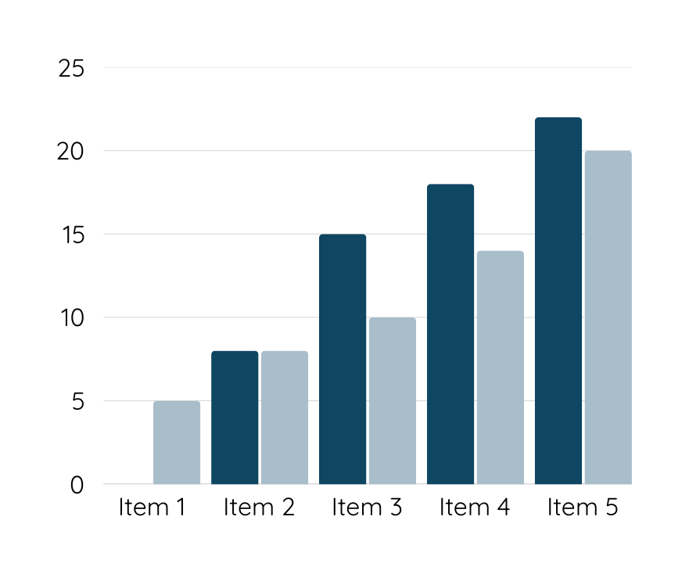
Financials
Provide a basic description of your financials and graphs or charts to back these up (Some options include but are not limited to, Break even point, Selling point, Cost to produce, etc.)

Slide 11
Ask
How much money do you need in order to start your company? How much do you hope to win from the competition? How will these funds be used?

Slide 12
Thank you

