Slide 1
Learning to Use Appropriate Tools Strategically for Bivariate Data Analysis
By: Matthew Jones and Mary Knaub
Mentor: Dr. Randall Groth

Slide 2
Introduction
Middle school students face several challenges in learning to analyze bivariate data. Such analysis is a complex cognitive process that involves:
Viewing the data as an aggregate rather than just employing case-based reasoning (Bakker, 2004)
Using context knowledge in ways that support, rather than interfere, with statistical reasoning (Batanero et al., 1996)
Discerning the direction of trend for data displayed in scatterplots (Cobb, McClain, & Gravemeijer, 2003)
Coordinating mathematical and statistical ideas in ways that support rather than interfere with one another (Casey, 2015)
Notes:
A schedule design for optional periods of time/objectives.

Slide 3
Introduction
Purpose
The purpose of this study was to investigate how students analyze bivariate data and then design an instructional sequence effective for helping them attain related CCSSM outcomes.
Research Question
What are the characteristics of an instructional sequence to help students use appropriate tools strategically when analyzing bivariate data?
Notes:
Introductory notes.

Slide 4
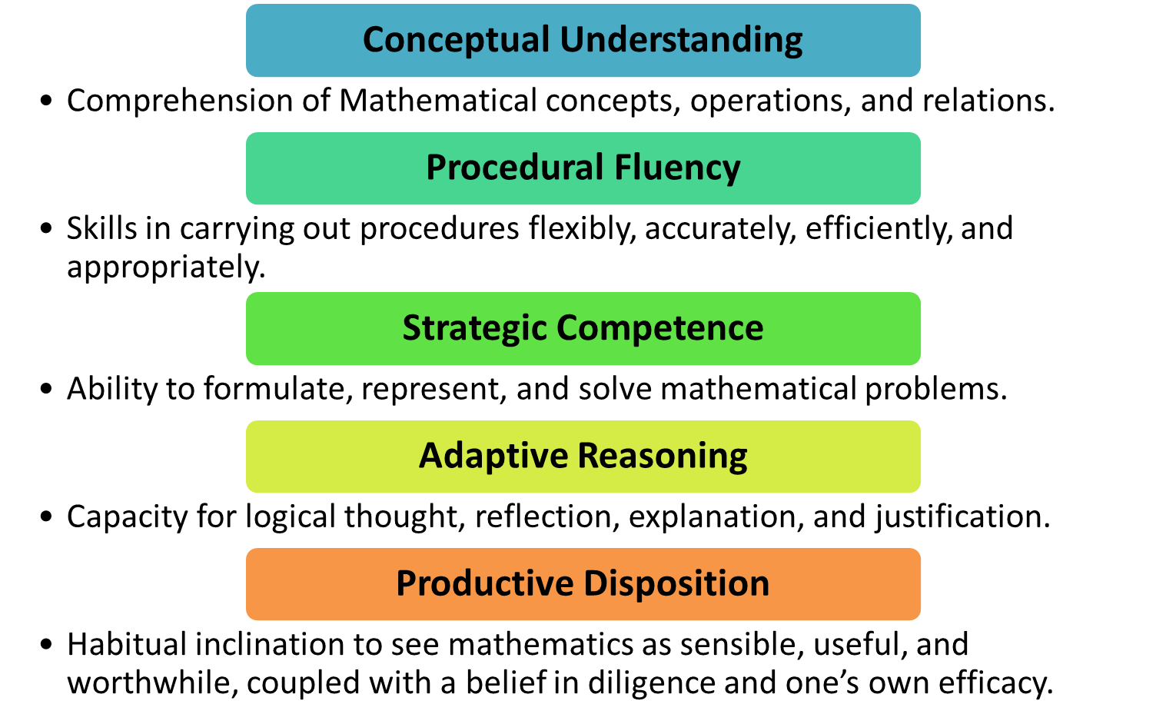
Theoretical Framework
The Five Strands of Mathematical Proficiency
are defined as five inter-dependent elements “… necessary for anyone to learn mathematics successfully” (Kilpatrick, Swafford, & Findell, 2001, p. 116)
Notes:
Beginning course details and/or books/materials needed for a class/project.

Slide 5
Learning Progressions
8.SP.4
Understand how to construct and interpret 2-way tables of bivariate categorical data for patterns of association based on relative frequencies.
8.SP.1
Use scatterplots with bivariate data to investigate association (positive, negative, or none), clustering, outliers, and linear and nonlinear association.
8.SP.2
Informally model linear relationships in scatterplots if appropriate and assess fit.
8.SP.3
Use the equation of a linear model to solve problems in the context of bivariate data, interpreting the slope and intercept.
A learning progression formulated by Maloney et al. (2014) helped us make conjectures about the optimal sequence for learning goals.
Practice-based articles (e.g., Kroon, 2016) and previous research (e.g., Casey, 2016) helped us select tasks, tools, and contexts to use to meet our instructional goals.
(Maloney, Confrey, Ng, & Nickell, 2014)
Notes:
Objectives for instruction and expected results and/or skills developed from learning.

Slide 6
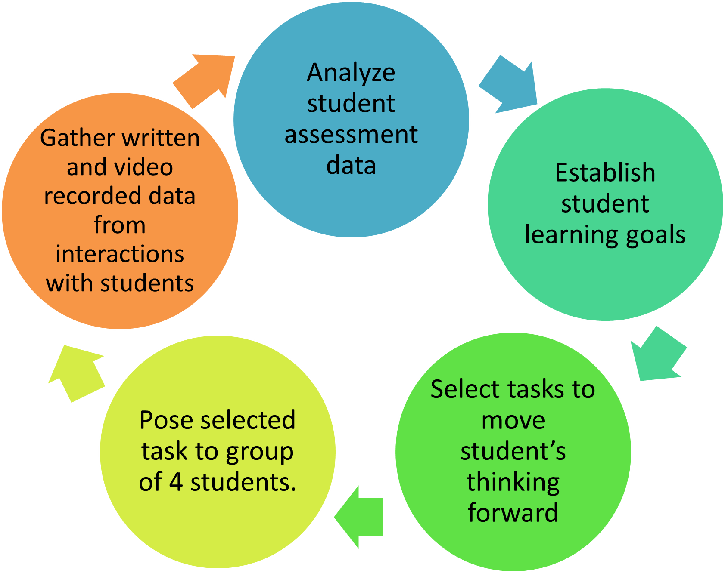
Methodology – Procedure & Participants
Participants: 4 students, 2 male, 2 female, going from 7th to 8th grade
Time Frame: 7 one-hour sessions, with a pre and post assessment interview
Participation Rate: One student consistently came late to a few sessions as well as missed a complete session.
Pseudonyms: Tom, Nick, Nancy, and Kate
PATHWAYS Instructional Cycle
Notes:
Relative vocabulary list.

Slide 7
Methodology: Data Gathering & Analysis
Interviews last for 30 minutes and were video recorded.
Students were asked to explain their thought process during and after completing each problem.
All problems were aligned with the Common Core State Standards and based on the sequence of the learning trajectory.

Slide 8
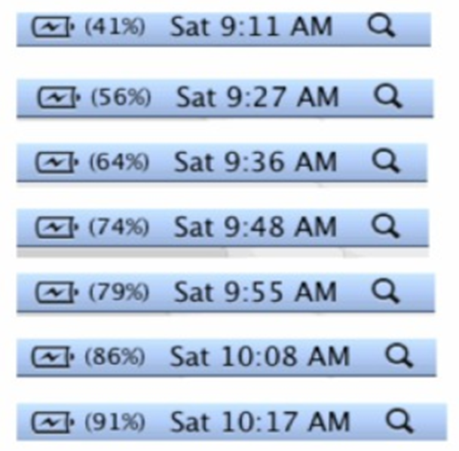
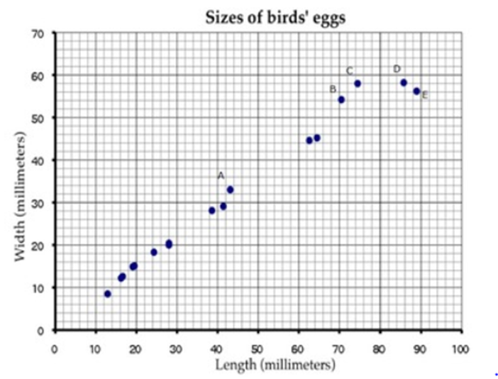
Methodology: Data Gathering & Analysis Cont.
Jerry forgot to plug in his laptop before he went to bed. He wants to take the laptop to his friend’s house with a full battery. The pictures below show screenshots of the battery charge indicator after he plugs in the computer at 9:11 a.m. When can Jerry expect to have a fully charged battery? Justify your answer.
This scatter diagram shows the lengths and widths of the eggs of some American birds.
A biologist measured a sample of one hundred Mallard duck eggs and found they had an average length of 57.8 millimeters and average width of 41.6 millimeters. Use an X to mark a point that represents this on the scatter diagram.
What does the graph show about the relationship between the length of birds’ eggs and their widths?
Illustrative Mathematics (modified): https://www.illustrativemathematics.org/content-standards/8/SP/A/2/tasks/1558
Illustrative Mathematics (modified): https://www.illustrativemathematics.org/content-standards/8/SP/A/1/tasks/41
Notes:
Example graph/chart.

Slide 9
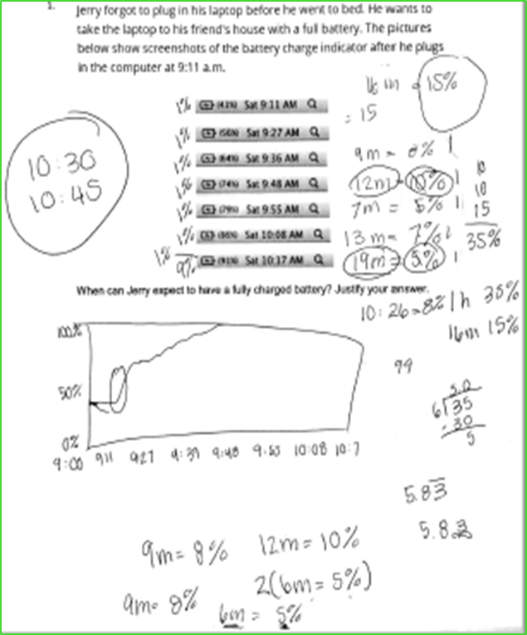
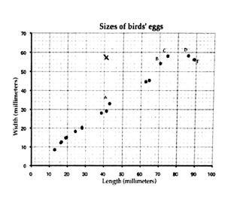
Initial Assessment Results
For key task 1, none of the students used a scatterplot or best fit line; therefore, it became our initial instructional goal to help the students see the usefulness of these tools.
For key task 2, three of the four students struggled to define the bivariate relationship shown in the scatterplot. This was an important concept we decided to build upon in the first lessons. Though students plotted a point, they did so incorrectly by reversing the coordinates od the variables.
Notes:
Example graph/chart.

Slide 10
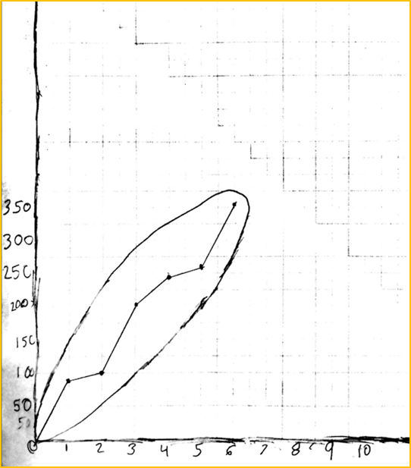
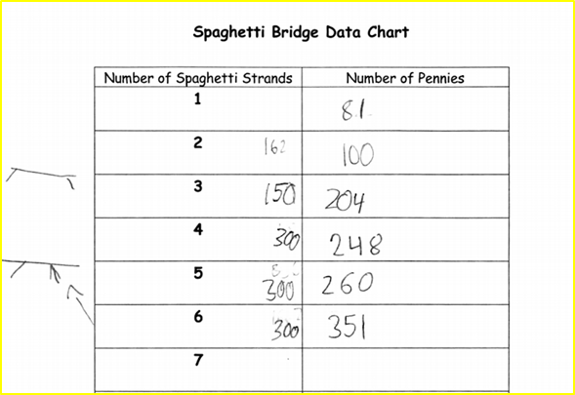
Weeks 2-3: Gathering & Representing Data
These lessons focused on the students gathering their own data. Students used spaghetti strands, pennies, and a cup to test how many pennies it took to break different numbers of strands bunched together. Students were then asked to represent the data in a manner they believed best displayed the data.
Notes:
Conclusion to course, lecture, et al.

Slide 11
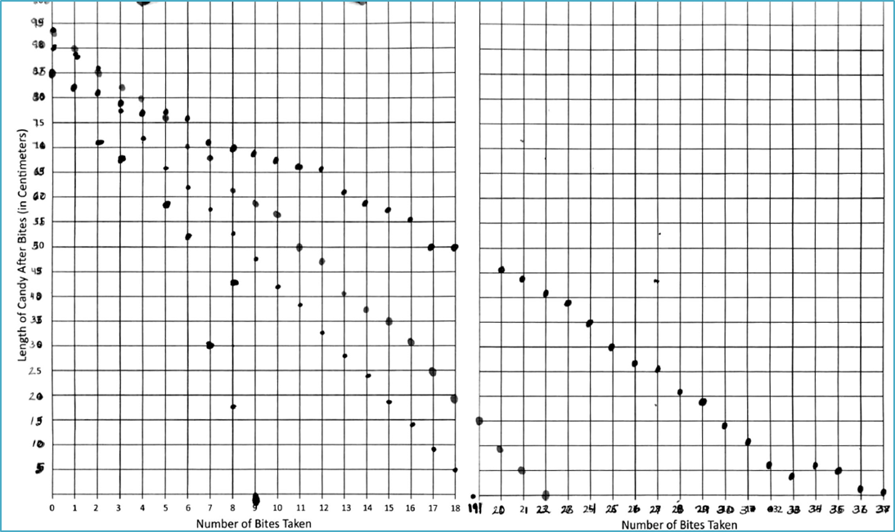
Weeks 4-5: Positive & Negative Associations
These lessons focused on helping students see linear patterns in relationships between variables. Students were given Fruit-by-the-Foot and took normal bites. They graphed the relationship between number of bites and amount left
This also gave them their first experience with a negative relationship between variables, allowing us to begin to discuss contexts that yield both positive and negative linear relationships.

Slide 12
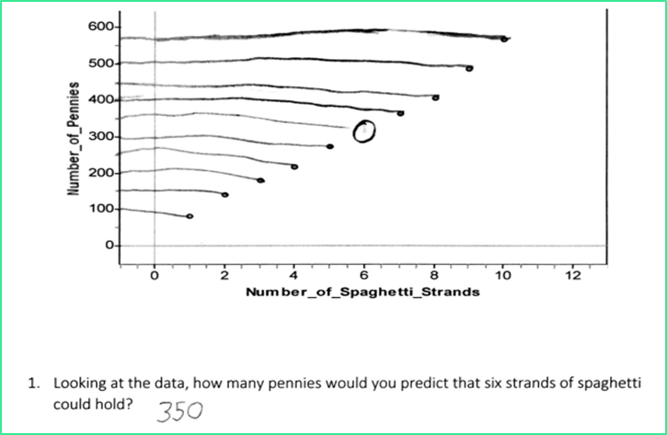
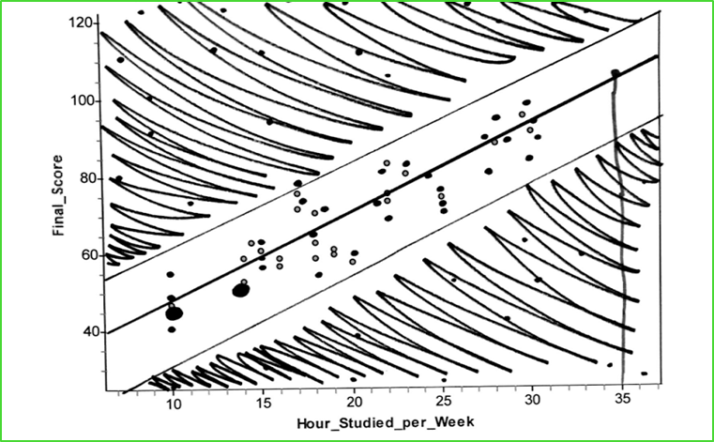
Weeks 6-8: Strategically Using Tools to Make Predictions
These lessons focused on predictions from bivariate data sets. One prevalent strategy students initially used to make predictions was to extend horizontal or vertical lines to individual data points, as shown below:
To help students see trend lines as useful tools, we used a data set on time spent studying vs. test score received.
This activity helped solidify trend lines as tools for making predictions, as will be indicated in the discussion of post-assessment results.

Slide 13
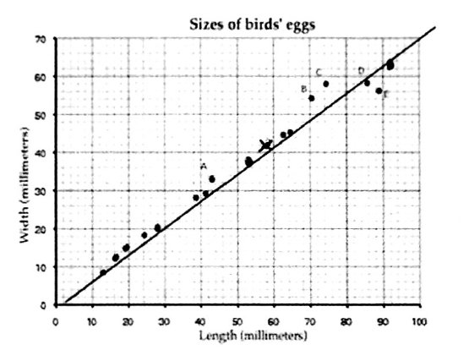
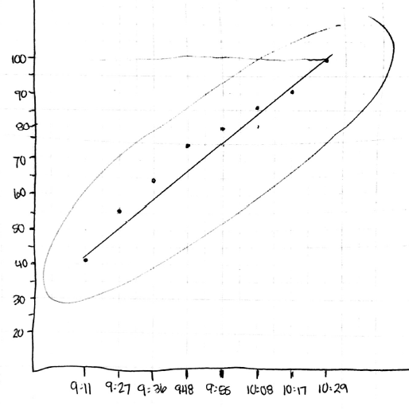
Post Assessment Results
For key interview task 1, one student constructed a scatterplot and used an informal line of best fit in order to help make the prediction the most accurate. Other students used various strategies such as trying to find a pattern within the data set, but seemed to only focus on one variable.
When responding to key task 2, three out of the four students were able to define the positive relationship shown, and informally placed a line of best fit through the data to assist them in predicting. However, only two of the students used a line of best fit across all interview contexts requiring predictions.

Slide 14
Reflection
It was evident that some of the CCSSM Standards were challenging to attain.
Students could construct scatterplots and interpret relationships in bivariate data.
They struggled to an extent deciding when to use the scatterplots.
Students need experiences across multiple context to begin to use trend lines as data analysis tools.
Our task sequence suggests that optimal engagement occurs when students deal with data they have collected themselves and when problem contexts are carefully selected by attending to students’ thinking.

Slide 15
References
Bakker, A. (2004). Reasoning about shape as a pattern in variability. Statistics Education Research Journal, 3(2), 64 – 83.
Batanero, C., Estepa, A., Godino, J., & Green, D. (1996). Intuitive strategies and preconceptions about association in contingency tables, Journal for Research in Mathematics Education, 27(2), 151-169.
Casey, S.A. (2015). Examining student conceptions of covariation: A focus on the line of best fit. Journal of Statistics Education, 23(1). Retrieved from www.amstat.org/publications/jse/v23n1/casey.
Casey, S.A. (2016). Finding what fits: Students explore six tasks to develop criteria for finding an informal line of best fit. Mathematics Teaching in the Middle School, 21 (8), 484-491.
Common Core State Standards Initiative. (2010). Common Core State Standards for Mathematics. Washington, DC: National Governors Association Center for Best Practices and Council of Chief State School Officers.
Cobb, P., McClain, K., & Gravejeijer, K. (2003). Learning about statistical covariation. Cognition and Instruction, 21(1), 1-78.
Kilpatrick, J. Swafford, & Findell, B. (Eds.) (2001). Adding it up: Helping students learn mathematics. Washington, DC: National Academy Press.
Kroon, C. D. (2016). Spaghetti bridges: Modeling linear relationships. Mathematics Teaching in the Middle School, 21 (9), 563-568.
Maloney, A.P., Confrey, J., Ng, Dicky, & Nickell, J. (2004). Learning trajectories for interpreting the K-8 Common Core State Standards with a middle-grades statistics emphasis. In K. Karp (Ed.), Annual perspectives in mathematics education: Using research to improve instruction (pp. 23-33). Reston, VA: National Council of Teachers of Mathematics.

Slide 16
Thank you!

