Slide 1
Demographic Decline in Student Population?
False Narrative from Strategic Plan Focus Group Briefing
Tim Dunn, Dept. of Sociology

Slide 2
Strategic Planning Focus Group Intro / Overview Briefing forecasts 15% drop by 2024 in college-age population (3/19/19 Focus Group Affordability, Accessibility and Attracting Students)
This suggests we need to prepare for contraction, cuts, and perhaps drastic changes.
However, this forecast is at best highly questionable for SU and Maryland generally, and more likely flat out wrong,
In fact, Maryland’s college-age population will grow 10% by 2024, according to MD public school data.
  (FYI, MD is source of 86% of SU students)
Thus, SU should be preparing for significant growth through 2025, not decline.
  There will be some decline after 2025, but we’ll still be above 2019 levels.

Slide 3
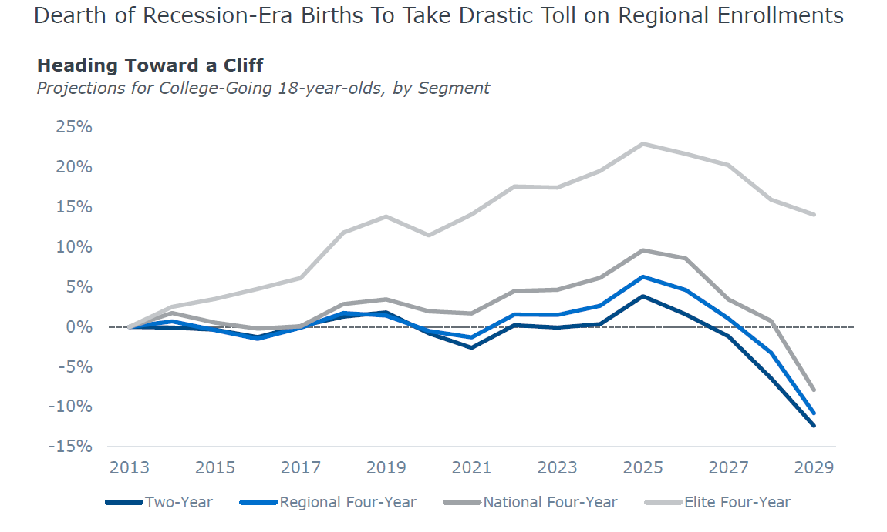
This forecast of national decline is highly debatable for MD (Nathan Grawe data) -- recession era births not drop much in MD

Slide 4
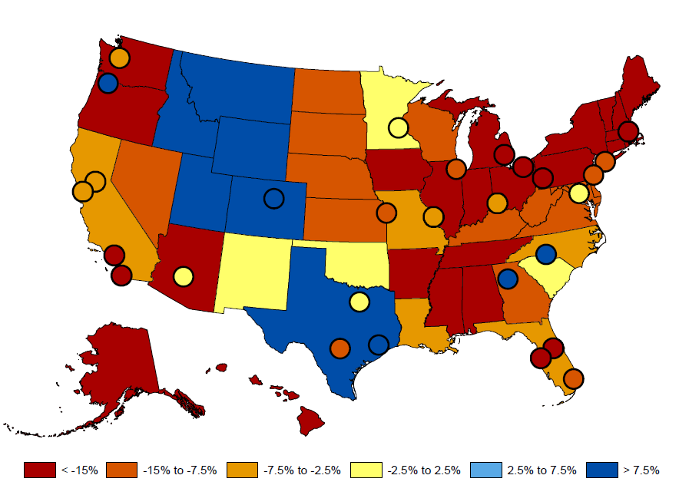
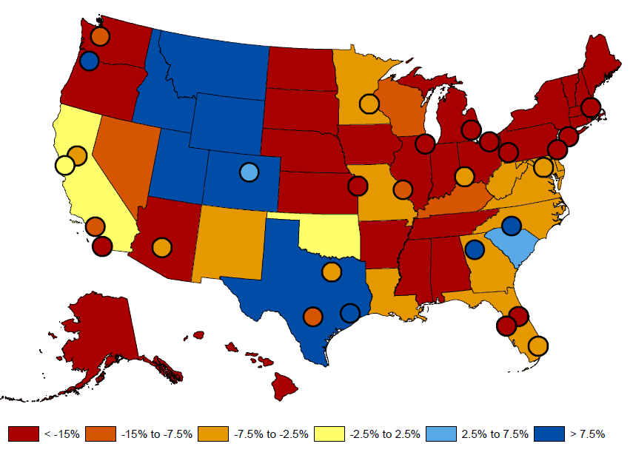
Forecast Decline for MD through 2029, using 2012 start point to project forward (Carleton College economist Nathan D. Grawe);
Forecasted growth in 18-year-olds, 2012 to 2029
Estimated MD drop 7.5%-15%
Forecasted growth in college-going students, 2012 to 2029
Estimated MD drop 2.5%-7.5%
https://people.carleton.edu/~ngrawe/HEDI/ColorAlternatives/Fig4.2C.pdf
https://people.carleton.edu/~ngrawe/HEDI/ColorAlternatives/Fig4.3C.pdf

Slide 5
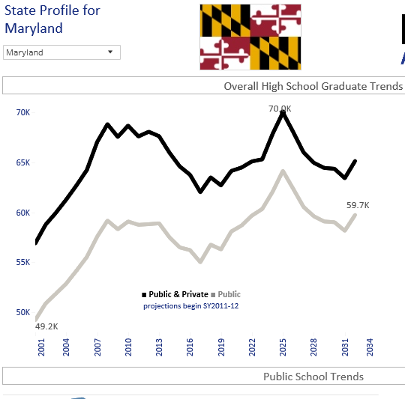
Decline forecast uses 2012 as start, high point in MD HS grads. (dropped 7% 2012-2017) but Significant Growth forecast 2017-2032 (Bell-Shaped)
https://knocking.wiche.edu/state-profiles
Western Interstate Commission for Higher Education (WICHE)

Slide 6
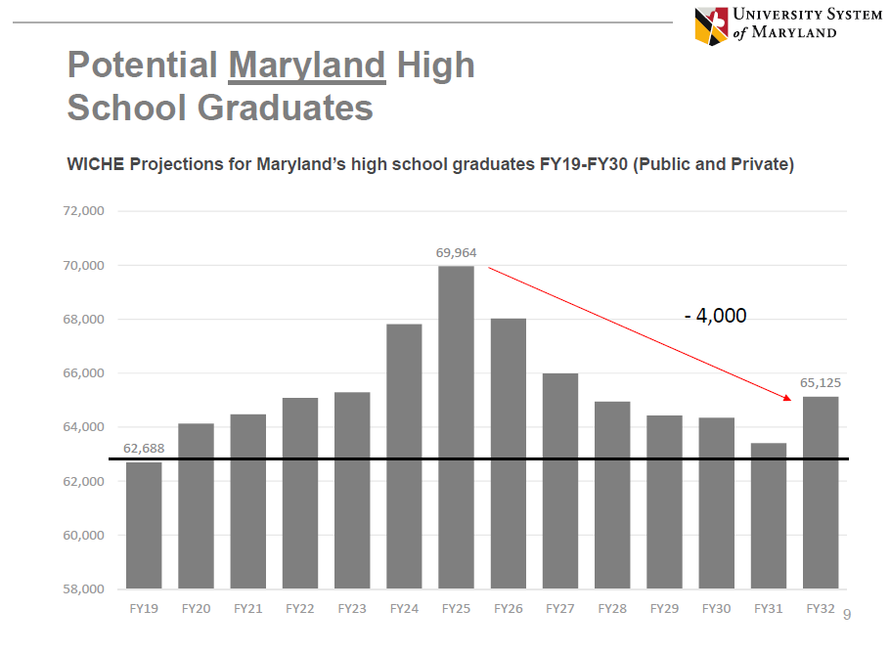

Demographic decline? NO, a Bell-Shaped fluctuation 2019-2032
10% increase by 2025 (7,000 stu’s) then 5.7% drop by 2032 (4,800) = net +3.9% above 2019. Should be preparing for growth!

Slide 7
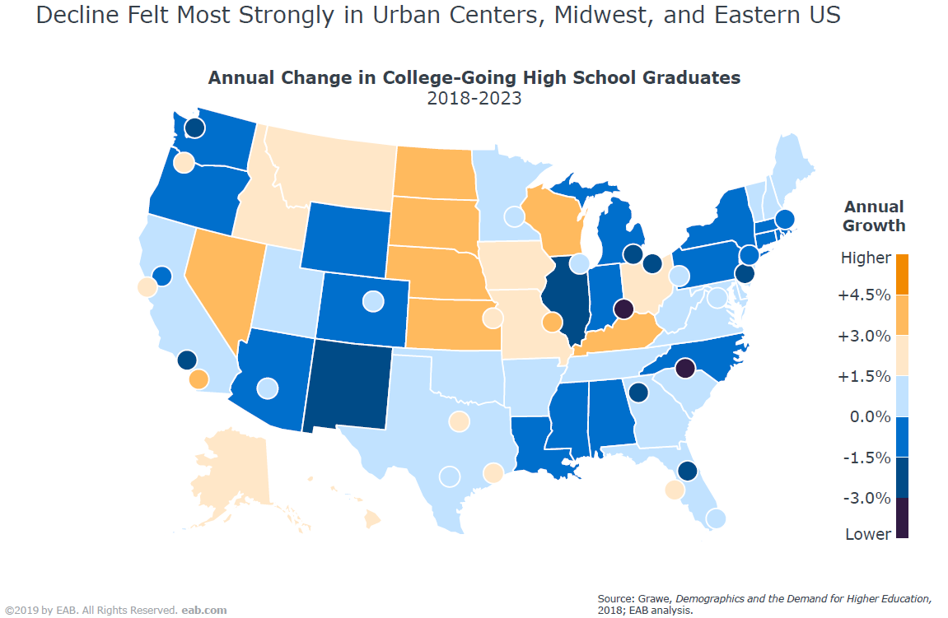
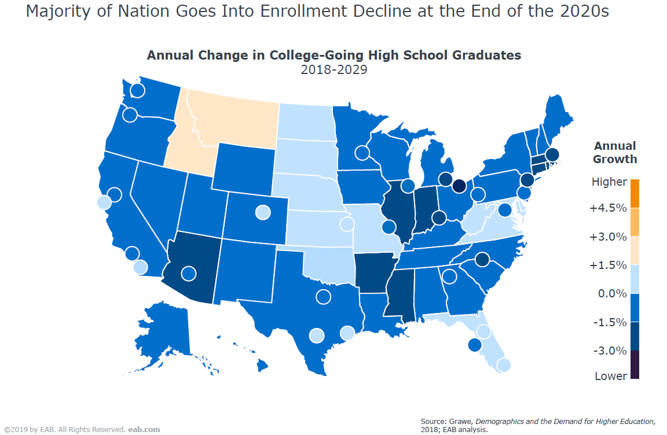
However, MD slight growth forecast 2018-2023 & 2018-2029
[Also using Nathan Grawe data, but from 2018 starting point, not 2012.
Note 2012 was a demographic high point.]
Source: Aaron Basko, “Students, Trends, and Challenges,” March 13, 2019 Presentation to Faculty Leadership Group

Slide 8
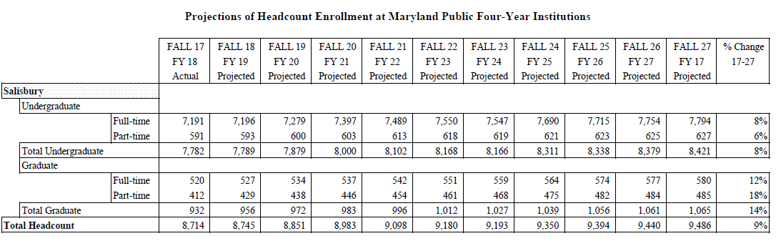
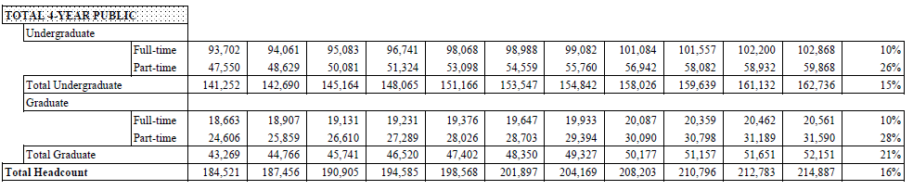
MD Higher Ed Commissions (MHEC) Enrollment Projections 2017-2027 –> SU +9%, MD Public Total +16%
https://mhec.state.md.us/publications/Documents/Research/AnnualReports/2018-2027EnrollmentProjections.pdf

Slide 9
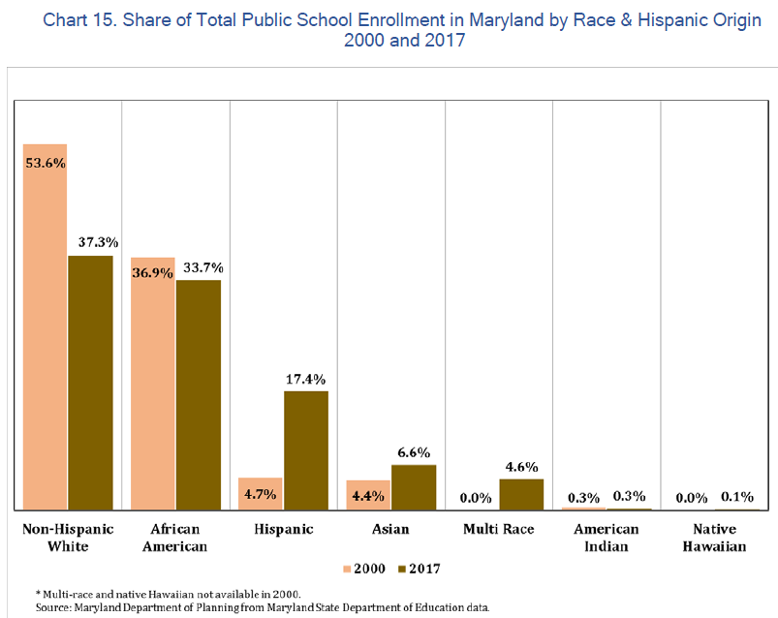
Much greater R&E diversity, esp. Latino, Asian Am., & Multi-race, 2000-2017
Chart 15, page 16 https://planning.maryland.gov/MSDC/Documents/school_enrollment/school_2018/Final-Public-School-Enrollment-Projections-Report-2018.pdf

Slide 10
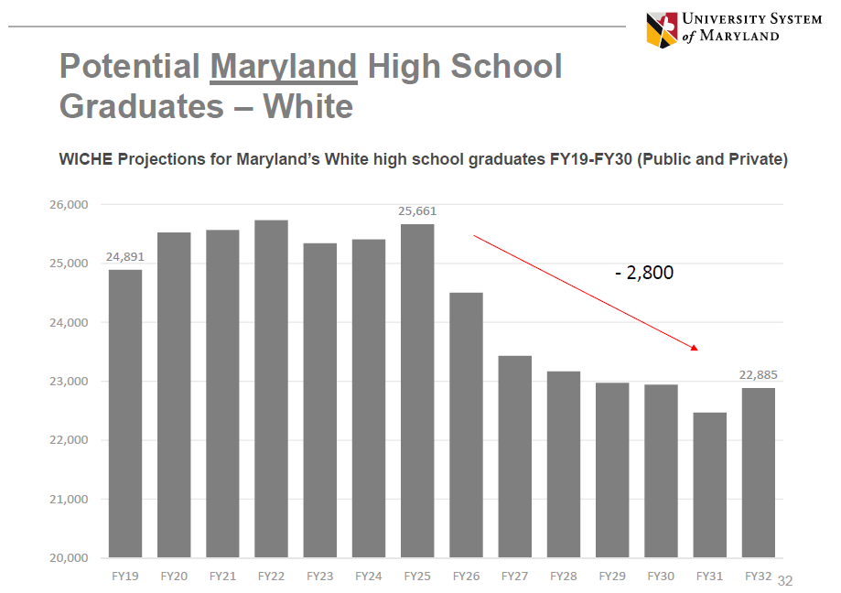
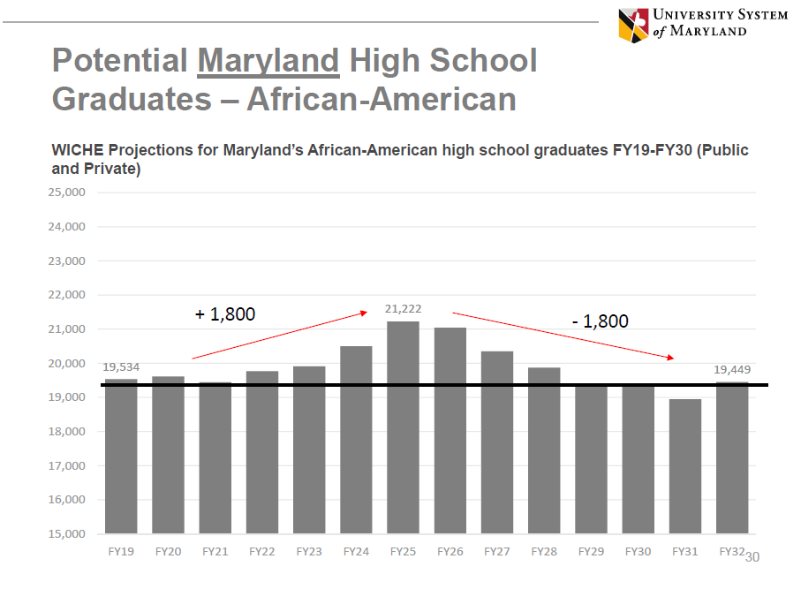
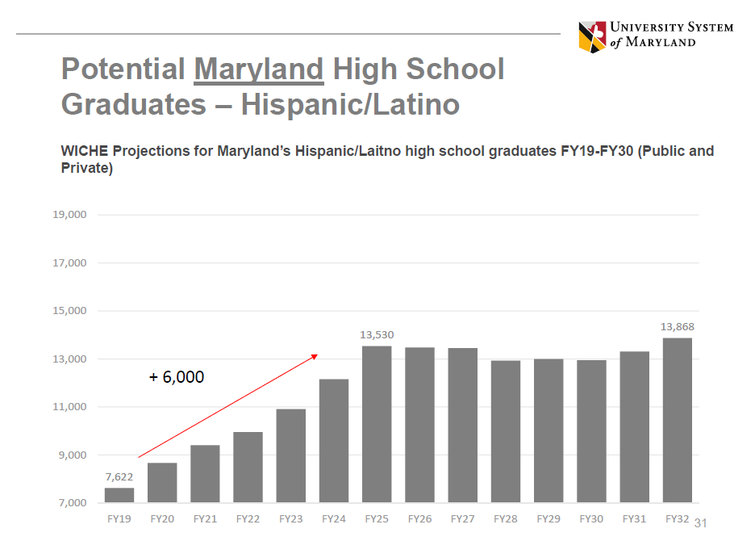
Greater Diversity in MD through 2032, esp. Latino growth

Slide 11
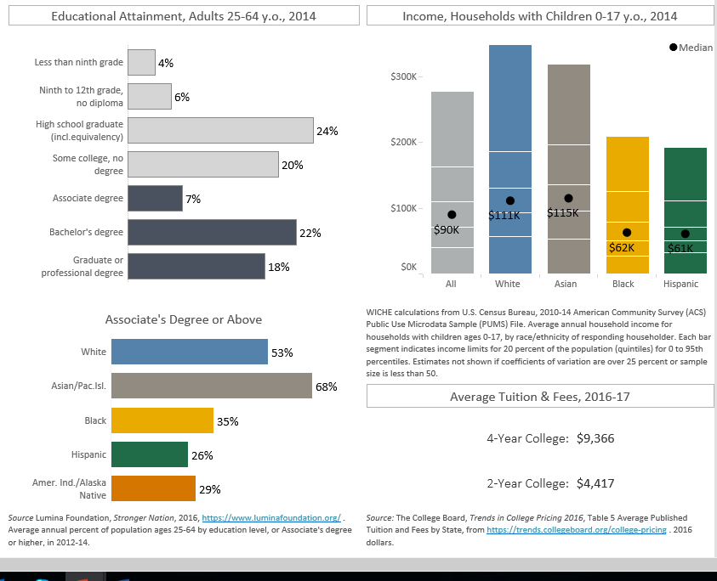
More R&E Diversity Not = Lower Higher Ed Enrollment
MD Educational & Income by Race
Large Gaps, but Black & Latino levels relatively high = good for higher ed. enrollment
https://knocking.wiche.edu/state-profiles

Slide 12
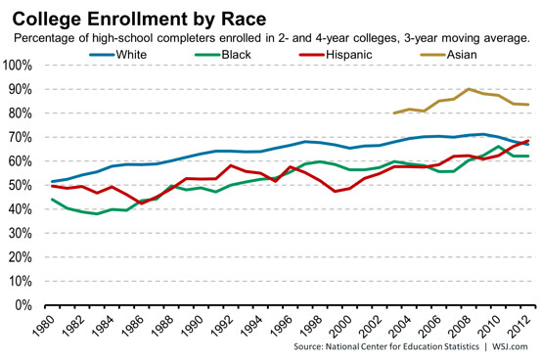
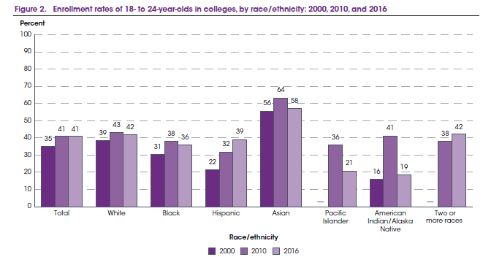
College Enrollment by Race – Small Gaps (except Asian Am.) → R&E diversity not mean lower College enrollments
2 year and 4 year college enrollment
4 year college enrollment
https://nces.ed.gov/programs/coe/pdf/coe_cpb.pdf

Slide 13
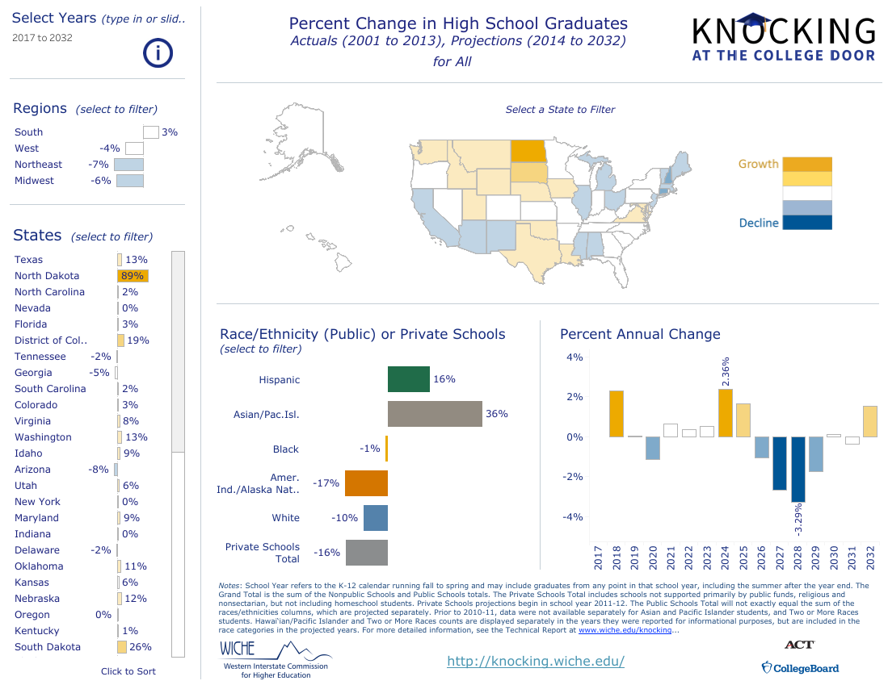
Regional Competition? Little Change HS Grads 2017-2032 = limited competition
MD & VA growth (8-9%), NJ down,
Rest of region unchanged
https://knocking.wiche.edu/percent-change-in-graduates

Slide 14
Conclusion
Fear of Demographic decline or change in Maryland is unfounded
  MD HS grad. population growing strongly through 2024, then decline, but less than growth
    2012-17 was period of demographic decline, but SU enrollment hardly changed
  MHEC projects 16% increase MD college enrollment through 2027
    Even economist Nathan Grawe (pessimistic) projects modest MD growth 2018-2029
  Greater Racial & Ethnic Diversity for 18-22 year olds already a fact, and expect more. However, this does not necessarily mean lower higher ed. enrollments
    Minority group enrolment gaps already narrowed
    MD median income for minority groups is much higher than national median for groups
  Regional competition should be modest, as only NJ has significant decline in HS grads
    SU’s main competition is other USM schools and UMCP has grown significantly
For Next 5-10 years, SU Strategic Plan should prepare for Growth, not Decline
  More student financial aid is needed to maintain access
  MD Community Colleges will be free for most start fall 2019 – Increase access? Increase SU recruiting?

