Slide 1
Salisbury University
Student Mental Health Resources
By: The Counseling Center

Slide 2
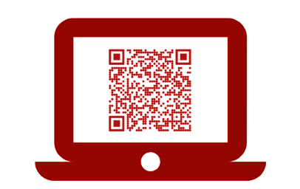
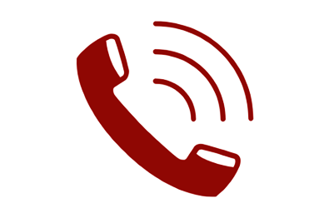
Counseling Center
Guerrieri Student Union, Room 263 • 410-543-6070 • Salisbury.edu/Counseling
Free confidential in-person services including:
Brief individual counseling
Daily walk-in hours for urgent needs
Referrals and consultations
Online Resources
Outreach events and workshops
Initiate a first appointment by:
Call 410-543-6070
Monday – Friday
8 AM - 4:30 PM
Scheduling online at Salisbury.titaniumhwc.com/
onlinescheduling or
scan QR code above

Slide 3
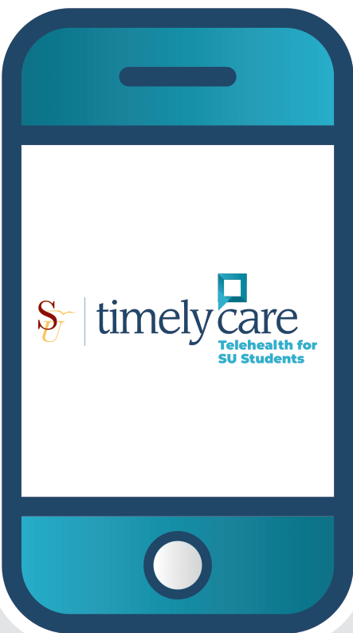

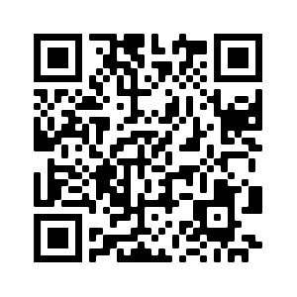
TimelyCare
Free, confidential virtual support:
24/7 mental health support
Scheduled counseling sessions
Basic needs assistance
On-demand self-care resources
Anonymous peer community
Initiate a first appointment by:
Scanning the QR code or visiting TimelyCare.com/Salisbury and registering with your SU email!

Slide 4


Outreach Events
Salisbury.edu/Counseling-Outreach
Creative Connections
  Come make art without pressure. Simple prompts, no experience needed, all supplies provided. Wednesdays at 2 PM in Room 206, GSU.
Paws for Mental Wellbeing
  Take a break and spend time with friendly therapy dogs from Pets on Wheels. Held the 2nd and 4th Thursday each month in Fireside Lounge, GSU.
Take Back the Night
  An evening focused on awareness, prevention, and support for survivors of sexual violence. Held in early April. Open to the public.
Out of the Darkness
  Join the campus community in supporting suicide prevention and the American Foundation for Suicide Prevention (AFSP). Held in late April. Open to the public.

Slide 5

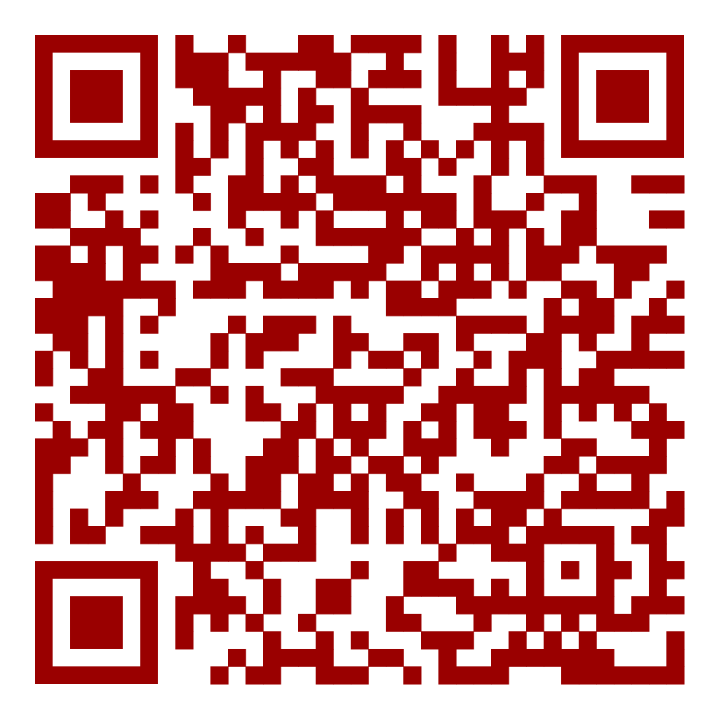

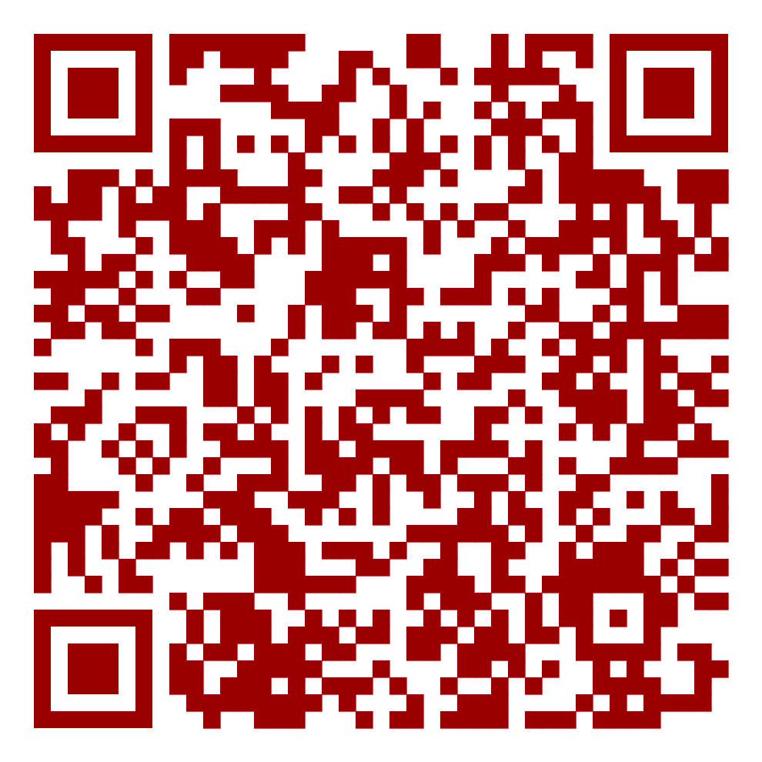

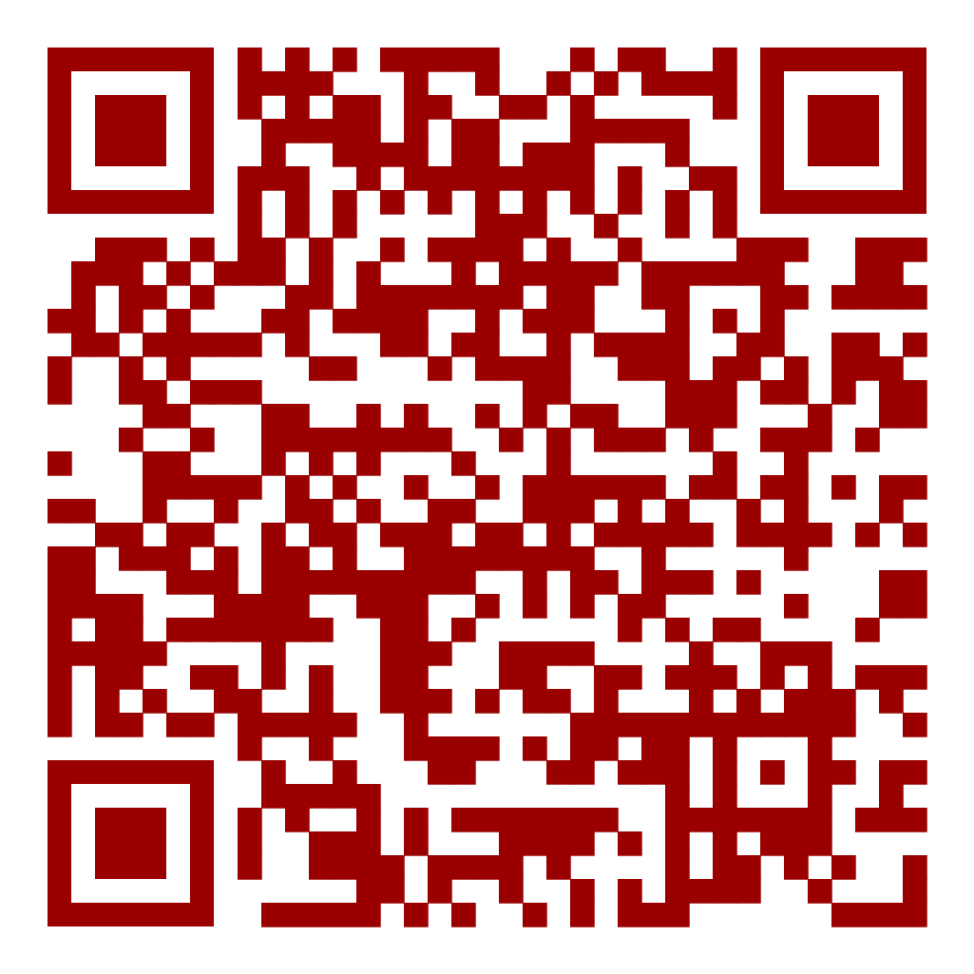
FAQ
Services are free for all students.
Insurance is not used for Counseling Center or TimelyCare services.
You do not need a diagnosis to receive counseling.
No concern is too big or too small.
Services are confidential, with limited exceptions related to safety.
Have more questions?
Visit the Center’s website at Salisbury.edu/Counseling or call 410-543-6070
Social media
Follow the Counseling Center to stay up to date with Counseling Center events and services!

