Slide 1
Rising Fourth-Grade Students’ Understanding of Fraction Equivalence
Skylar Nock & Mackenzie Peperak
Faculty Mentor: Dr. Jathan Austin

Slide 2
Introduction
Fractions pose one of the biggest challenges to students despite being an incredibly important building block to further mathematical understanding.
The National Assessment of Education Progress (NAEP) found that less than half of fourth graders perform at or above the “proficient” level in mathematics (National Center for Education Statistics, 2013).
Mack (1990) found that in general, students do not often have a deep understanding of fraction concepts.
The purpose of our study was to investigate students' thinking about and understanding of fraction equivalence and design an instructional sequence to help it develop.
Research question: How do students’ abilities to give conceptual explanations of fraction equivalence develop?

Slide 3
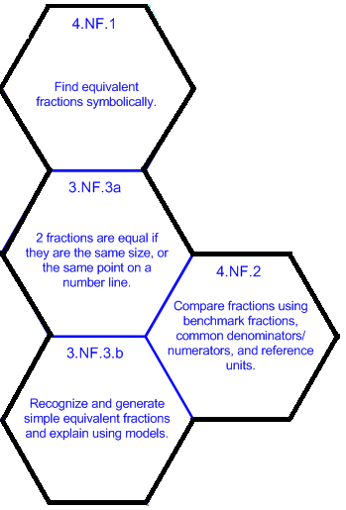
Core Standards
The diagram to the right shows the learning progression that guided our research. Our main focus was Common Core standards 4.NF.1 and 4.NF.2.

Slide 4
Literature Review
Existing literature contains teaching strategies that can help students attain these standards.
Empson (2001) showed how children can use equal sharing strategies like splitting and chunking to create an understanding of fraction equivalence.
Bray and Abreu-Sanchez (2010) explained the importance of real-world contexts and the use of manipulatives is in the understanding of fractions.
Lewis, Gibbons, Kazemi, and Lind (2015) expressed the importance of examining students’ explanations. They showed why discussion is important in revealing a student’s true understanding of what they are doing.

Slide 5
Methodology
Students Camilla, Carol, Will, and Dalton (pseudonyms) just finished third grade and were advancing to fourth grade. Students had a 100% participation rate during the ten-week study involving two interviews and seven one- hour lessons. Lessons were video recorded and transcribed for analysis. Instruction focused on fraction equivalence and comparison.

Slide 6
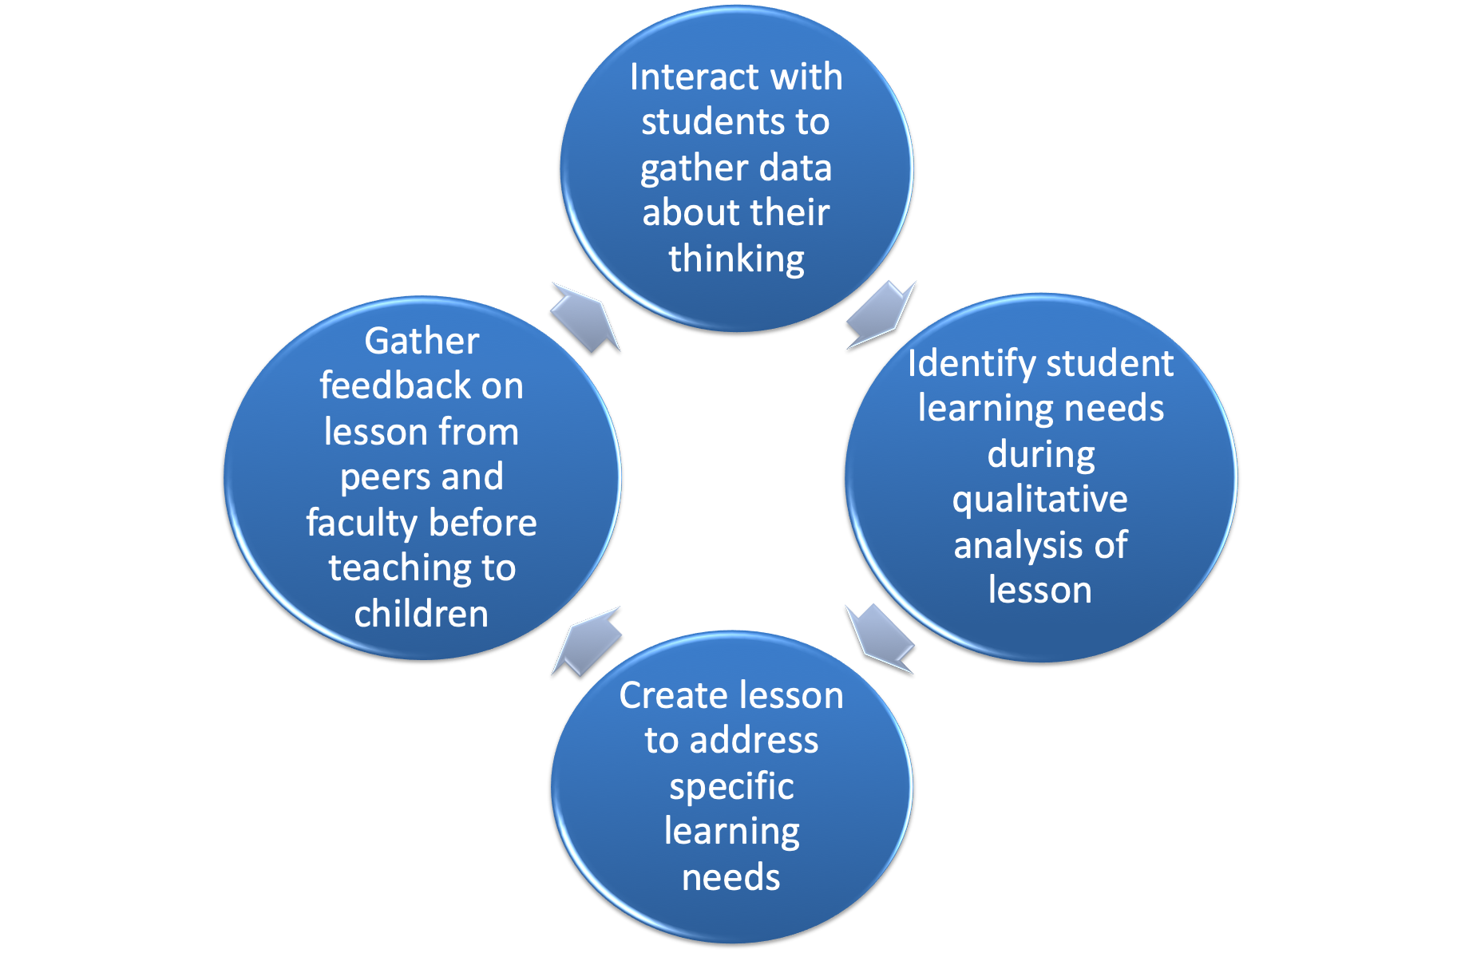
Instructional Cycle
We utilized this cycle
multiple times
over the course of
the study to create
lessons that targeted
our learners’ needs.

Slide 7
Pre- and Post-Interviews
Interviews were conducted one-on-one with a GoPro video camera and an audio recorder. Students were not corrected, only prompted with further questions to understand their thinking. Videos were then transcribed and coded to understand and analyze student thinking.

Slide 8
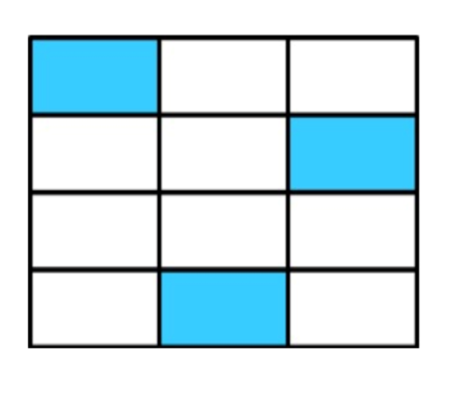
Key Item One
In key item one, students were
asked what fraction of the
rectangle was shaded. Students
then had to explain if they believed
that 1/4 of the rectangle was shaded.

Slide 9
Initial assessment of Key Item #1
All four students were able to recognize fractions from a visual representation in key item one.
Three of the four students agreed that 1/4 and 3/12 were equivalent. Dalton gave a partial explanation, saying they were the same because “3 x 4 is 12.” Carol’s partial explanation for them being equivalent was “because 3/12 is the same as 1/4.”
Will did not think the fractions were equivalent saying “there was twelve boxes in there, and she says only four boxes were in there. And then she said there was one shaded and there was three shaded.” Will’s reasoning suggested he did not believe fractions with different denominators could be equivalent.

Slide 10
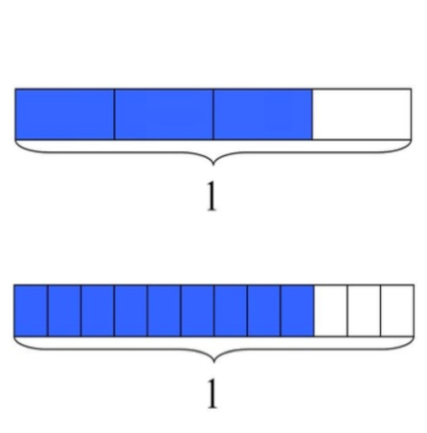
Key Item Two
In key item two, students were
to say which portion of each
rectangle was shaded. They
were also to explain if the
fractions shown by the
shaded areas were equivalent.

Slide 11
Initial assessment of Key Item #2
For this key item, two of the students used part-whole reasoning to explain their thinking. Camilla said, “ because it’s put into three lines so that’s four squares but three of them are shaded and one wasn’t so it’s three out of four.”
Will was not able to recognize equivalent fractions. He said that 3/4 and 9/12 were not equivalent because “one has like short boxes and the other one has long boxes.”

Slide 12
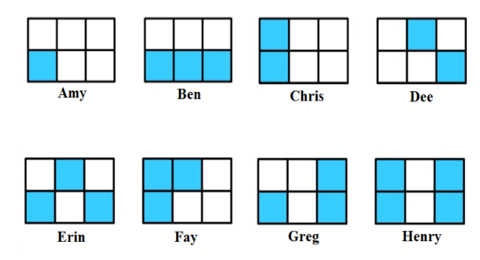
Key Item Three
In Key Item three, students
were shown figures
representing partially eaten
candy bars. They were to order from least to most eaten,
find the fraction eaten, write
the fraction multiple ways, and
show multiple ways to indicate one-half.

Slide 13
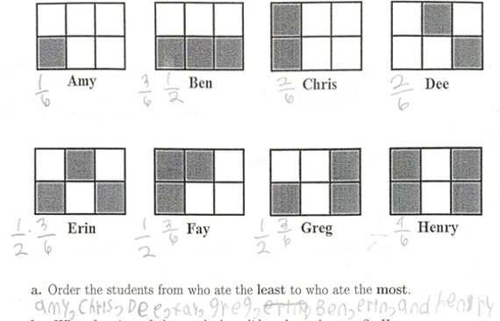
Initial Assessment of Key Item #3
All four of the students were able to accurately compare the fractions and order them from least to greatest.
This is a picture of Dalton’s work that shows he accurately ordered the fractions from least to greatest.

Slide 14
Overview of Lessons

Slide 15
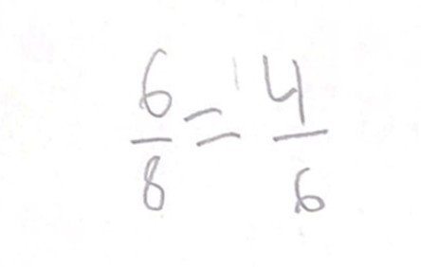
Lessons 1
During our first lesson we wanted to gauge the children’s understanding of fractions.
We had students recognize fractions from a representation then they created their own fractions and drew the corresponding representation.
Then we wanted to see how much they understood about fraction equivalence. We had them list examples of fractions that they thought were equivalent. They gave some correct and incorrect responses.
This is an example of a fraction that Carol wrote down. She claimed that they were equivalent fractions because they lined up when she drew them.

Slide 16
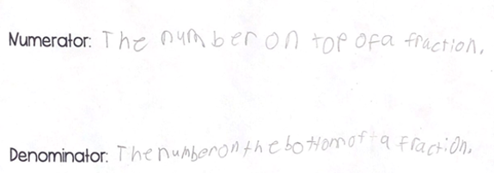
Lesson 2
During lesson two we continued looking at examples of equivalent fractions. Students were given some correct and incorrect examples.
They were asked to determine if they were equivalent or not by shading fraction bars. All answered correctly except for Will.
After that we wanted to get an understanding of how deeply they understood fraction vocabulary. They had a create your own definition worksheet. They gave vague definitions.
This picture shows the definitions that Camilla recorded for numerator and denominator. They are vague definitions that do not display a deep understanding of the terms.

Slide 17
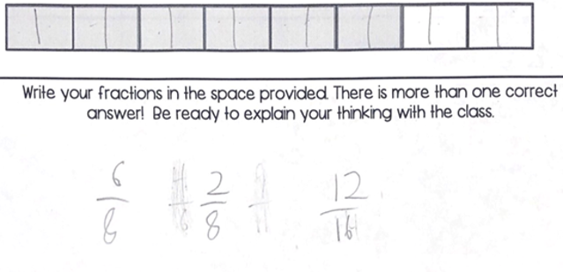
Lessons 3 and 4
For these two lessons we shifted our focus to using fraction strips to further their understanding of fraction equivalence.
We had them cut out and label the fraction strips. Then they found equivalent fractions using them.
For lesson four we wanted to give them a deeper understanding of why fractions are equivalent and that you can see multiple fractions from the same visual representations.
We wanted to get away from unit fractions so we worked with fractions that couldn’t simplify into unit fractions.
These pictures show some chunking and splitting strategies that Will and Carol used in the fourth lesson to find equivalent fractions.

Slide 18
Lessons 5, 6, and 7
For the last three lessons we focused on utilizing different types of manipulatives in order to reinforce ideas of splitting of chunking.
In lesson five we used buttons and had the students create fractions using different attributes to group them together.
In lesson six students used snap cubes to recognize fractions. Then from that they were asked to create equivalent fractions
In lesson seven we used the snap cubes again in a different situation to prompt splitting and chunking vocabulary more explicitly. Students worked through an activity sheet and taught the class by explaining their thinking and strategies.

Slide 19
Post- Assessment Results

Slide 20
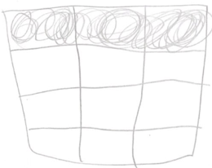
Post assessment of key item #1
All four students recognized from the visual representations that 3/12 was shaded. However, only one student said that 3/12 and 1/4 were equivalent. This is different from the pre-interview where three out of four said they were equivalent. Dalton used part whole reasoning to explain fraction equivalence. He said “there’s four sections and one of each is shaded.”
This picture shows how Dalton redrew the representation to show that 3/12 and 1/4 are equivalent.

Slide 21
Post assessment of Key item #2
All but one student was able to recognize the fractions from the two visual representations. Carol miscounted and said 8/12 instead of 9/12. When asked how they knew that the two fractions were equivalent three out of the four students said it was because they lined up in the picture. This showed major improvement for Will, who in the pre-interview said they were not equivalent. Camilla used pre-proportional reasoning to explain why they were equivalent.
This photo shows the pre-proportional reasoning that Camilla used for this key item

Slide 22
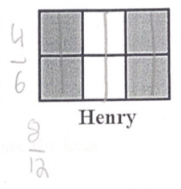
Post assessment of key item #3
All four students were able to accurately compare fractions with like denominators. When asked to come up with other names for the fractions Carol used the splitting strategy. She said “I split them in half. Now four blocks are shaded and there are 12 blocks.” This was her explanation as to why 2/6 and 4/12 were equivalent.
This picture shows Carol’s splitting strategy to show how 4/6 and 8/12 are equivalent

Slide 23
Reflection and Discussion
Students struggled with creating equivalent fractions that could not be halved. Students only wanted to double or half all fractions to find an equivalent fraction
We found learning progression 3.NF.3.b “Recognize and generate simple equivalent fractions and explain using models,” to be the most difficult for our students.
Students are able to be helped through this learning progression through the use of discrete manipulatives. This takes away students' ability to rely on doubling a fraction to get an equivalent fraction. When students received a visual representation of a fraction with an odd denominator using snap cubes students realized they were unable to “double” the denominator by cutting the cubes in half and deemed it impossible to find and equivalent fraction due to the odd denominator. This helped our students make gains toward a deeper conceptual understanding of creating equivalent fractions

Slide 24
References
Bray. W ., & Abreu-Sanchez .L. Using number sense to compare fractions reflect and discuss. Teaching Children
Mathematics, 17 (2), 90-97.
Empson. B.S. (2001). Equal sharing roots and the roots of fraction equivalence. Teaching Children Mathematics,
7(7),421-424.
Mack, N. K. (1990). Learning fractions with understanding: Building on informal knowledge. Journal Research in
Mathematics Education, 21. 16-32.
Lewis. M.R, Gibbions. L.K, Kazemi. E, & Lind. T. (2015). Unwrapping students’ ideas about fractions. Teaching
Children Mathematics, 22 (3), 158-168.
National Center for Education Statistics. (2013). A first look: 2013 mathematics and reading. Retrieved
From http://nces.ed.gov/nationsreportcard/subject/publications/main2013/pdf/2014451.pdf

